Slide 1
PNB Bank HR –
Mandatory Training
Dashboard
INDUSTRY
FUNCTION
PNB Banking & Financial Services
Human Resources (HR)
HR PROBLEM
Track completion, pending training and training hours across departments.
PRESENTATION BY GROUP 4
01 / 09
Notes:
Introduction. This is an internal assessment for Business Analytics. I used Power BI to turn a banking HR training dataset into a dashboard that answers one practical question: who has completed mandatory training, who is still pending, and how many hours are being spent, department by department. The industry is banking and financial services and the function is Human Resources. Mandatory training matters in banking because compliance topics such as KYC and AML are regulatory requirements, so HR needs a quick view of gaps.

Slide 2
Understanding the HR Training Dataset
SAMPLE DATA • ACADEMIC USE
KEY FIELDS
Employee ID
Employee identifier
500
Department
Groups employees by function
fictional employee records
Training Status
Completed or Pending
Training Hours
Time spent in training
Data source
Training Priority
High, Medium or Low
Synthetic/sample HR training data prepared for academic Power BI practice — not real company data.
TRAINING PRIORITY | 500 EMPLOYEES
Medium
278 (55.6%)
Each row represents one employee.
High
205 (41.0%)
The fields support summaries by department, training status and priority.
Low
17 (3.4%)
Source: Training Priority chart in the Power BI dashboard.
02 / 09
Notes:
The dataset. It has 500 employee records, one row per employee. This is synthetic sample data prepared for academic practice, not real company data. The fields are Employee ID, Department, Training Status (Completed or Pending), Training Hours and Training Priority (High, Medium or Low). The priority split on the right comes straight from the dashboard: 278 Medium (55.6%), 205 High (41%) and 17 Low (3.4%). These fields let us summarise by department, status and priority.

Slide 3
Key Performance Indicators
These three measures give HR a quick snapshot of training progress.
TOTAL EMPLOYEES
AVERAGE TRAINING HOURS
PENDING TRAINING
500
13.9
215
Employee count
Average of Training Hours
Count where status = Pending
Workforce records represented in the dashboard.
Displayed average training time per employee.
Employees whose training is still pending (43% of 500).
Training priority split: Medium 278 (55.6%) • High 205 (41%) • Low 17 (3.4%)
03 / 09
Notes:
Key performance indicators. Three cards sit at the top of the dashboard. Total employees is 500. Average training hours is 13.9 per employee. Employees with pending training is 215, which is 43% of the workforce (215 divided by 500). So more than four in ten employees still have mandatory training outstanding. These values are read from the dashboard as displayed.

Slide 4
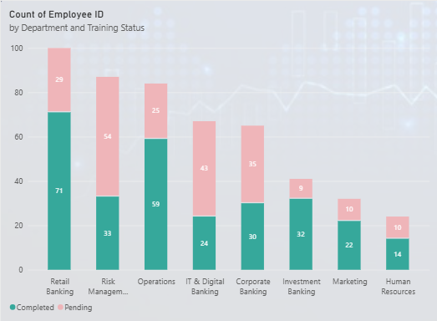
Completed vs Pending Training by Department
Count of Employee ID | Stacked by Training Status
KEY FINDING
100
Risk Management
29
80
33 completed
25
54 pending
60
54
87 employees in total
43
35
40
9
71
HR interpretation
59
10
Largest backlog. IT & Digital has the highest pending share (64.2%).
20
33
10
30
32
24
22
14
0
Retail
Banking
Risk
Management
Operations
IT & Digital
Banking
Corporate
Banking
Investment
Banking
Marketing
Human
Resources
Axis: Department • Measure: Employee ID count
Completed
Pending
04 / 09
Notes:
Chart 1: completed versus pending by department. Each bar is a department and is split into completed and pending employees. Retail Banking is the largest department with 100 employees (71 completed, 29 pending). Risk Management has the largest pending count: 54 of 87 employees. IT and Digital Banking has the highest pending share: 43 of 67, which is 64.2%. Corporate Banking has 35 of 65 pending. Investment Banking is the best performer with only 9 of 41 pending. The takeaway is that raw counts and percentages tell slightly different stories, so HR should look at both before targeting follow-up.

Slide 5
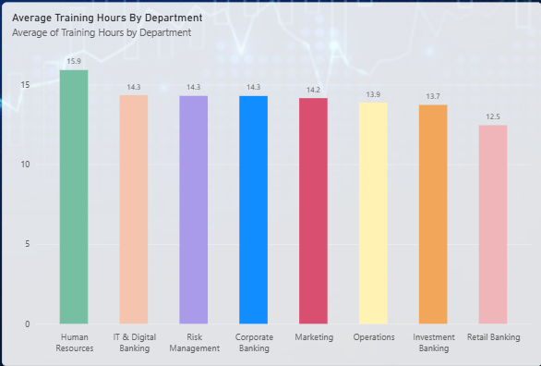
Average Training Hours Across Departments
Average of Training Hours by Department
KEY FINDING
15.9
Highest average
15
14.3
14.3
14.3
14.2
13.9
13.7
HR • 15.9 hrs
12.5
Lowest average
10
Retail Banking • 12.5 hrs
Difference: 3.4 hours
5
This is a difference in average training time—not proof of training effectiveness or compliance.
0
Human
Resources
IT & Digital
Banking
Risk
Management
Corporate
Banking
Marketing
Operations
Investment
Banking
Retail
Banking
Axis: Department • Measure: Average Training Hours
05 / 09
Notes:
Chart 2: average training hours by department. Human Resources has the highest average at 15.9 hours. IT and Digital, Risk Management and Corporate Banking are all at 14.3, Marketing is 14.2, Operations 13.9, Investment Banking 13.7, and Retail Banking is lowest at 12.5. The gap between highest and lowest is 3.4 hours. Caution: a difference in average hours is not proof that training is more effective or that a department is more compliant.

Slide 6
ML Method: Learning Type and Model Inputs
Supervised learning with logistic regression predicts whether an employee’s training will lapse (Pending).
MODEL OPTIONS BY PREDICTION GOAL
PREDICTION GOAL
TARGET
LEARNING TYPE
MODEL
Will training lapse?
Training Status
Supervised (classification)
Logistic regression
WHY LOGISTIC REGRESSION
The outcome has two classes (Completed or Pending), so logistic regression gives the probability that training lapses.
Logistic regression is a supervised learning method that predicts the probability that an observation belongs to a class. It is mostly used when the outcome has two possible values, such as Yes/No, Pass/Fail or Pending/Completed.
07/ 09
Notes:
ML method. This is supervised learning because the data has a labelled outcome: Training Status. The model is logistic regression because the outcome has two classes, Completed or Pending, and logistic regression gives the probability that training lapses. Linear regression would suit a continuous target such as training hours, and unsupervised methods such as k-means have no label and would only group similar employees. Inputs are Department, Training Hours and Training Priority. The target is Training Status with Pending coded as 1. Limit: with no skill or module column, a true skill-gap prediction is not possible; adding one would enable it.

Slide 7
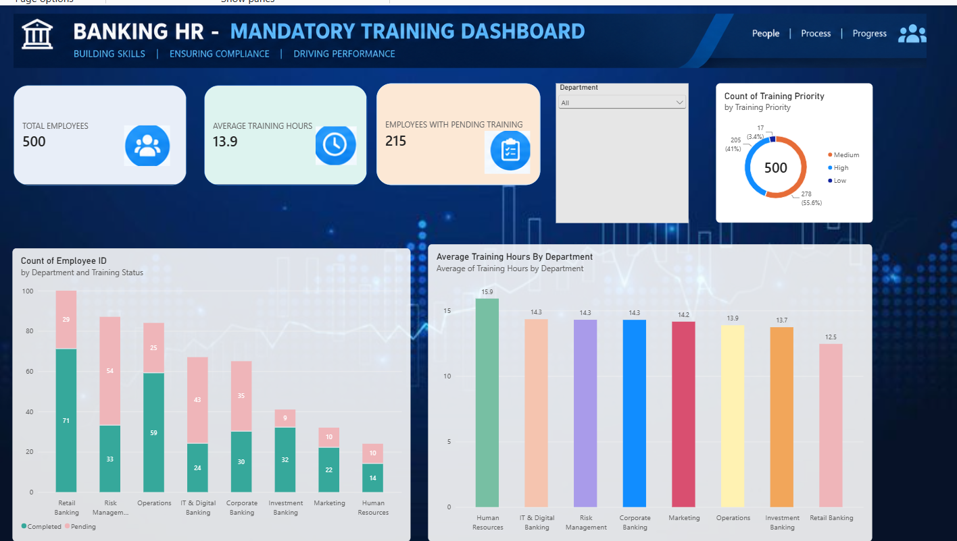
Interactive Power BI Dashboard
01
02
03
04
Slicer = All: 500 employees, 13.9 hrs, 215 pending.
06 / 09
Notes:
Live dashboard. This is the Power BI report. The Department slicer filters every visual. With the slicer on All we see 500 employees, 13.9 average hours and 215 pending. For the demo: open the report, pick one department, watch the cards, the priority donut and both bar charts update, then select All to reset. Values change depending on the department selected.

Slide 8
ML Model: Training Lapse and Skill-Gap Prediction
ML INSIGHT
A machine-learning model was applied to the dashboard fields (department, training status, hours, priority) to predict where each department’s training is lapsing and which skill sets are at risk.
DEPARTMENT
PENDING
HOURS
LAPSE RISK
PRIMARY LAPSE AREA
SKILL SETS AT RISK
IT & Digital Banking
64.2%
14.3
High
43 of 67 pending: highest pending share
Cyber security and data privacy; digital fraud awareness
Risk Management
62.1%
14.3
High
54 of 87 pending: largest backlog
AML and KYC; operational risk; regulatory compliance
Corporate Banking
53.8%
14.3
High
35 of 65 pending
Credit due diligence; sanctions and AML; corporate KYC
Human Resources
41.7%
15.9
Medium
10 of 24 pending despite highest hours
Code of conduct and ethics; employee data privacy
Marketing
31.3%
14.2
Medium
10 of 32 pending
Fair-marketing and disclosure norms; customer consent
Operations
29.8%
13.9
Low
25 of 84 pending; hours at average
Process controls; fraud detection; transaction monitoring
Retail Banking
29.0%
12.5
Low
Lowest training hours (12.5)
KYC basics; customer conduct; mis-selling prevention
Investment Banking
22.0%
13.7
Low
9 of 41 pending: best completion
Market conduct; conflicts of interest; insider-trading rules
08 / 09
Notes:
ML insight: lapse and skill-gap view. I applied a machine-learning approach to the dashboard fields to flag where each department's training is lapsing. Pending percentage is pending employees divided by department headcount, taken from the dashboard counts. Risk bands: High is 50% or more pending, Medium is 30 to 49%, Low is under 30%. IT and Digital, Risk Management and Corporate Banking are High. Human Resources and Marketing are Medium. Operations, Retail Banking and Investment Banking are Low, although Retail has the lowest training hours at 12.5. Important: the dashboard has no skill field, so the skill sets listed (for example AML and KYC for Risk Management, cyber security and data privacy for IT) are indicative areas mapped to each department's training focus. They should be confirmed against the actual model output.

Slide 9
Key Insights and HR Actions
FINDINGS
RECOMMENDATIONS
LIMITATIONS
Risk Mgmt has most pending (54); IT & Digital the highest share (64%).
Prioritise follow-up in Risk Management, IT & Digital and Corporate Banking (over 50% pending).
Synthetic data; not a real bank workforce.
Associations do not establish causation.
HR averages 15.9 hours; Retail Banking averages 12.5.
Use the ML lapse and skill-gap view to target modules and review training-hour gaps by department.
Figures alone do not prove effectiveness or compliance.
215 of 500 employees (43%) are pending; 205 (41%) are High priority.
ML skill-gap results are indicative; validate before acting.
09 / 09
Notes:
Conclusion. Findings: Risk Management has the most pending employees (54) and IT and Digital the highest share (about 64%); HR averages 15.9 hours against 12.5 for Retail Banking; overall 215 of 500 employees (43%) are pending and 205 (41%) are High priority. Recommendations: prioritise follow-up in Risk Management, IT and Digital and Corporate Banking, where over half are pending, and use the lapse and skill-gap view to target modules and review hour gaps. Limitations: synthetic data, associations are not causation, figures alone do not prove effectiveness or compliance, and the ML skill-gap results are indicative. AI-use declaration: AI assisted with structure and wording; the student verifies the calculations and understands the analysis. Close with questions.

Slide 10
THANK YOU

